Slide 1
Understanding TDES and Its Implementation
SYED SAHIL A

Slide 2

Introduction to Encryption
Process of converting plaintext into ciphertext to secure data.
Protects sensitive data from unauthorized access.
Ensures confidentiality, integrity, and authenticity.
Evolution from simple ciphers to complex encryption algorithms.

Slide 3
Triple DES (TDES)
An encryption algorithm that enhances the security of the original Data Encryption Standard (DES) by encrypting data three times.
Developed to counteract DES vulnerabilities due to its shorter key length.
Ensures confidentiality, integrity, and authenticity.
Uses a 56-bit key in three stages, effectively making it a 168-bit key (with caveats in keying options).

Slide 4
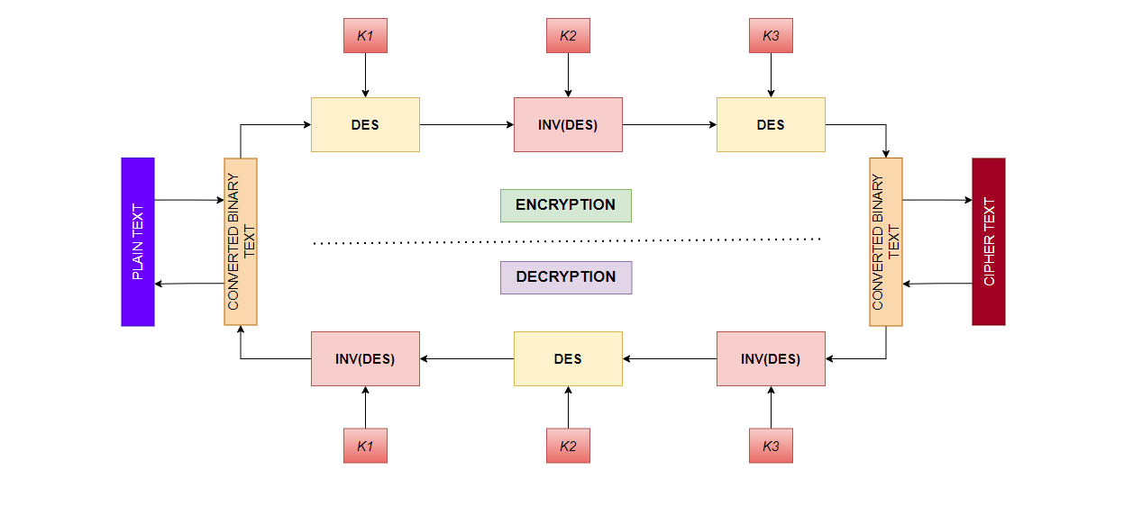
WORKING OF TDES

Slide 5
IMPLEMENTATION
A password is taken from the form of sign up and sign in page.
It is then converted to binary format.
Then patched with trailing zeros if it doesn’t have Nx64 bits.
Then the patched text is encrypted and stored in a database or authenticated from the database.
Link for application: Click Here

Slide 6

THANK YOU

